Slide 1
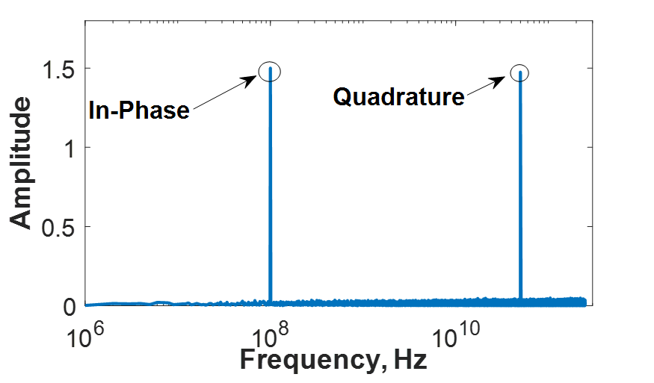
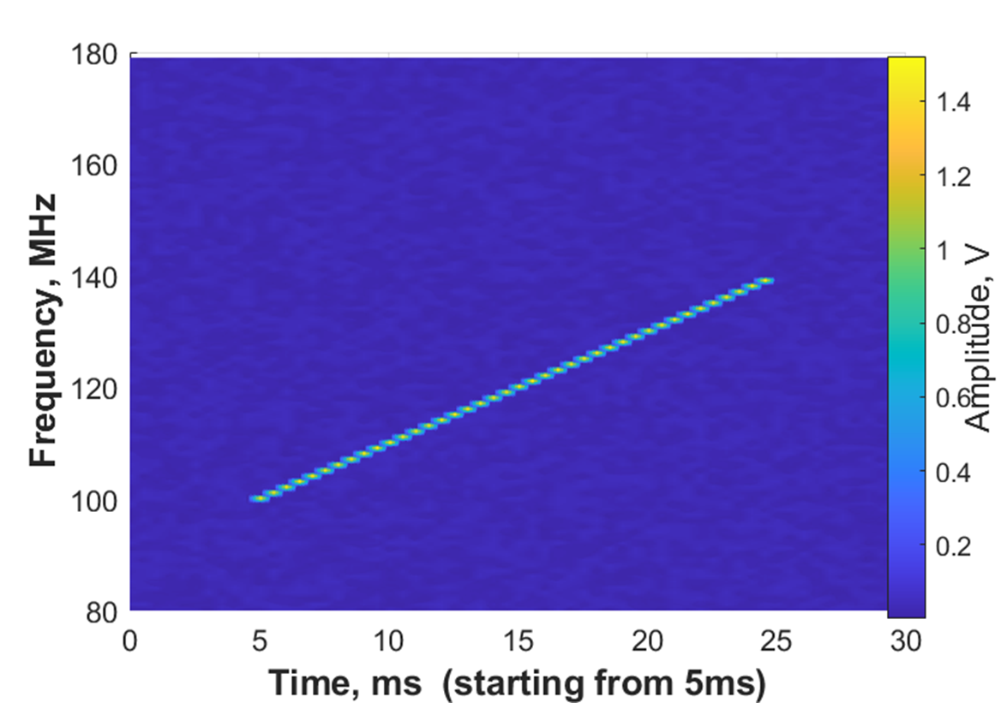
MATLAB simulation of detector part
LO
Noise
Radiation source
Amplifier
FFT
Mixer
Amplitude
In Phase
spectrum
quadrature
Spectrum
(discarded)
Frequency
Radiation source (chirped sine with 1V amplitude from 25GHz to 25.04GHz);
LO = 24.9GHz; random white noise; Amplifier: 10dB;
FFT: single-sided.
Spectrogram

